Slide 1
Calm Chores
Fall 2024 Team 4
CS 673 Software Engineering Project
Anup
Keshav
Xiaoyue
Fernanda
Chun Qin

Slide 2
Scope
Task Management: The app will facilitate efficient management of household chores, ensuring all members can view and manage assigned tasks seamlessly.
Scheduling Flexibility: Users will have the ability to schedule and reschedule tasks, catering to individual preferences and changes in routine.
Public Ratings System: Implementing a public ratings system will promote accountability and transparency among users, helping to maintain a fair environment.
Integration of To-Do Lists: The app will offer an integrated to-do list feature to track chores and other responsibilities, ensuring nothing is overlooked.
Bill Payment Reminders: Users will have the option to set reminders for bill payments related to household expenses, improving financial management within shared living situations.

Slide 3
Goals
Enhance Collaboration: The app aims to improve collaboration among roommates by providing a clear overview of tasks and responsibilities.
Foster Accountability: Through public ratings and feedback, the app seeks to foster a sense of accountability among all users, encouraging timely task completion.
Reduce Overburdening: By fairly distributing tasks, the app will help prevent any single roommate from feeling overburdened with chores.
Encourage Participation: The implementation of a point-based reward system will motivate users to engage more actively in completing their assigned tasks.
Improve Communication: The app will enhance communication regarding shared responsibilities, leading to a more harmonious living environment.
Target users: Any person sharing a house with roommates

Slide 4
Roles and Responsibilities
Keshav Saraogi - Project Manager, Backend Developer, Q/A
Schedule Team Meetings. Manage Jira tasks, and maintain team progress.
Write robust backend API, Quality Assurance, and Testing
Chun Qin Huang - Full-Stack Developer
Creates Database schemas and a responsive web interface.
Develops the product features and functionalities in Java
Fernanda Nano - Frontend Developer, QA
Implement front-end interfaces and functionality.
Test the front-end code block
Xiaoyue Zhang - Full-Stack Developer, UI/UX
Front-end interface visualization design
Front-end and back-end functionality implementation and testing.
Anup Sindagi - Frontend Developer, UI/UX
Create designs for user interface and design, test user interaction, and improve designs.
Create React components/UI for the finalized design.

Slide 5
High Level Project Requirements
User Registration and Authentication: Users can easily register and login securely, with options for password recovery.
Task Management: Create, assign, and manage chores, ensuring tasks are organized and easily accessible.
Fair Task Distribution: Automatically rotate tasks among users to maintain an even workload and prevent overload.
Public Ratings System: Users can rate each other’s task performance, promoting accountability and transparency.
Point-Based Reward System: Encourage participation by rewarding points for timely task completion that can lead to perks.

Slide 6
Additional Project Requirements
Scheduling and Vacation Mode: Users can set task schedules and activate vacation mode to pause assignments while away.
Integrated To-Do Lists: Personal to-do lists for additional responsibilities, integrated with the main task management system.
Bill Payment Reminders: Reminders for upcoming bills and tracking shared expenses to ensure financial awareness.
User-Friendly Interface: A clean, intuitive design for an enjoyable user experience across devices.
Data Security and Privacy: Commitment to secure data storage and compliance with data protection regulations.

Slide 7
Technology Stack
Frontend:
React Native for the core app
NativeWind for CSS styling
Expo Go for routing the screens and sandboxing the app to test
Figma for initial UI/UX designs
Backend:
Node.js for API server
Firebase Firestore for database
Firebase Authentication for user management

Slide 8
Updates on API
Currently, Chun and Keshav are working on the API for the backend functionality of the project. The DB and API proposal has been accepted and we have begun our implementation on the Schemas, followed by the API.
For the database, we chose Firebase and are currently implementing the Rest API for the backend service, which will be tested using Postman.
We will make changes to the schemas if needed in the future as we test and implement our API to fit it with the frontend.
As we implement the application we might add more schemas and API to give the application more features.

Slide 9
Updates on GUI
We were able to set up a test project using Expo Go and tested it’s functionality.
We worked on initial Figma design and decided on the UI features
We start working on the layout of the App and built essential features and screens.
We were successfully able to implement Firebase Authentication on the app and connected to Firestore DB to test all the possible features.
We finished working on the initial login screen, signup screen and tasks screens of the app with all the functionality working as expected.

Slide 10
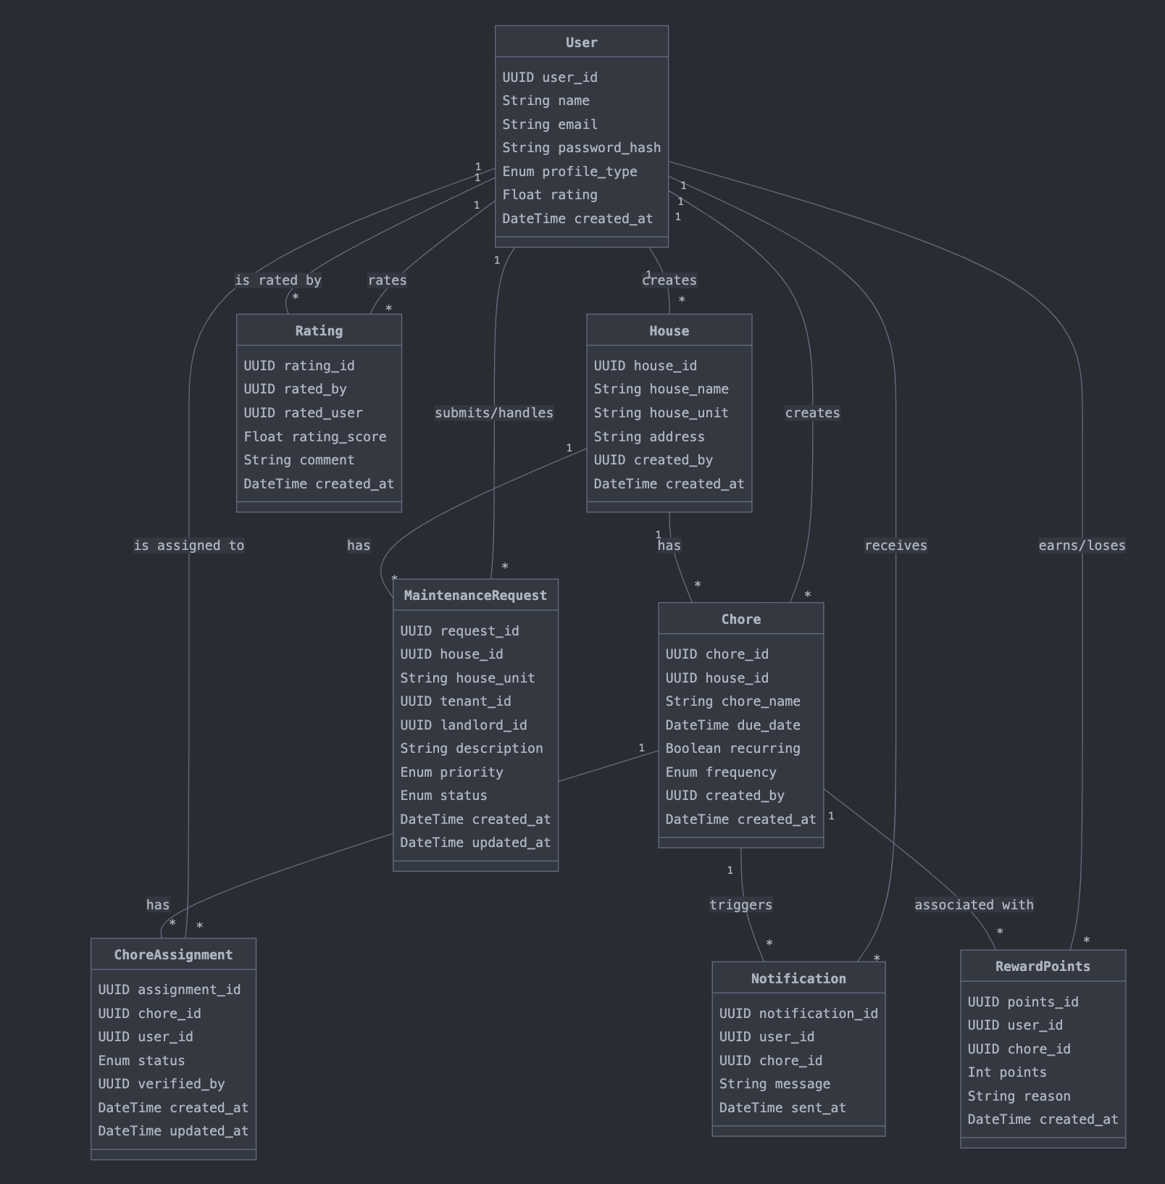
Entity Relationship Diagram

Slide 11
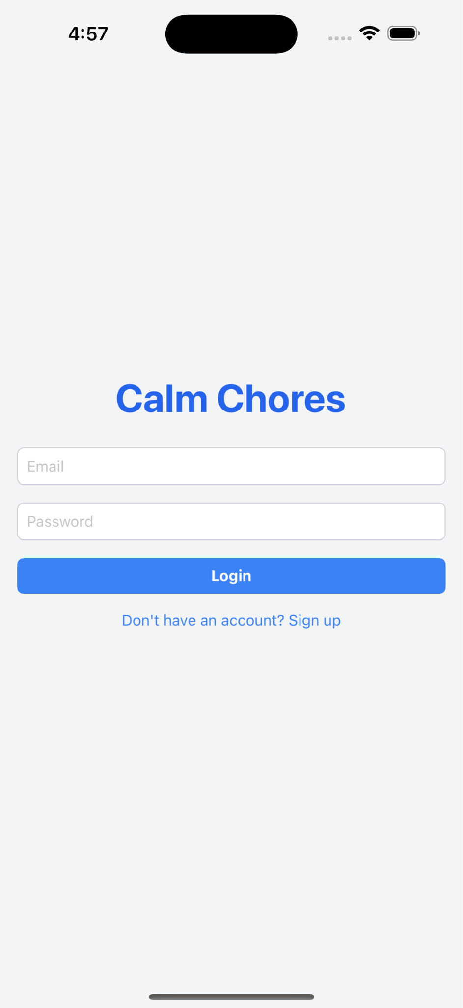
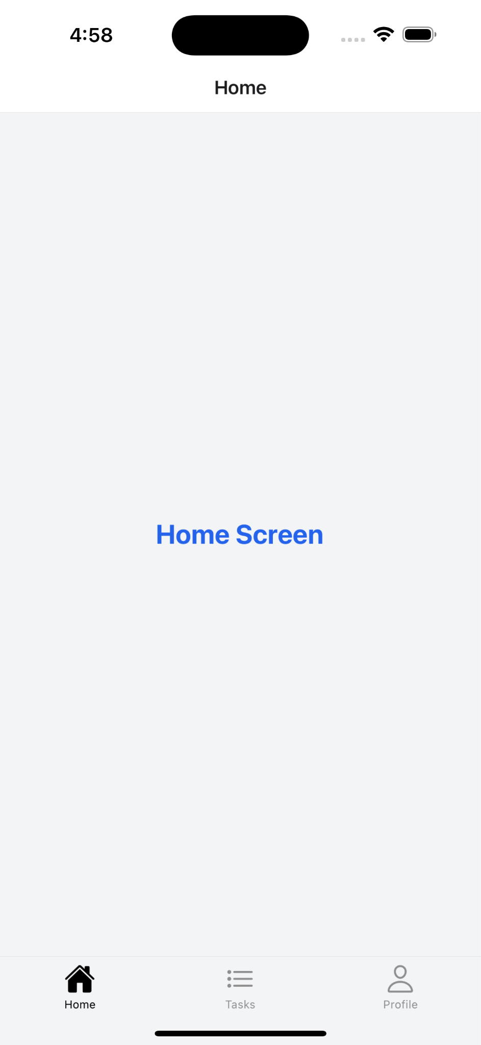
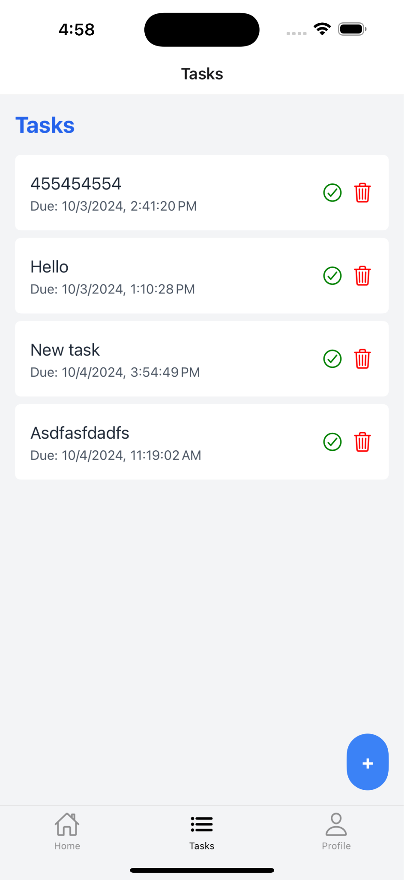
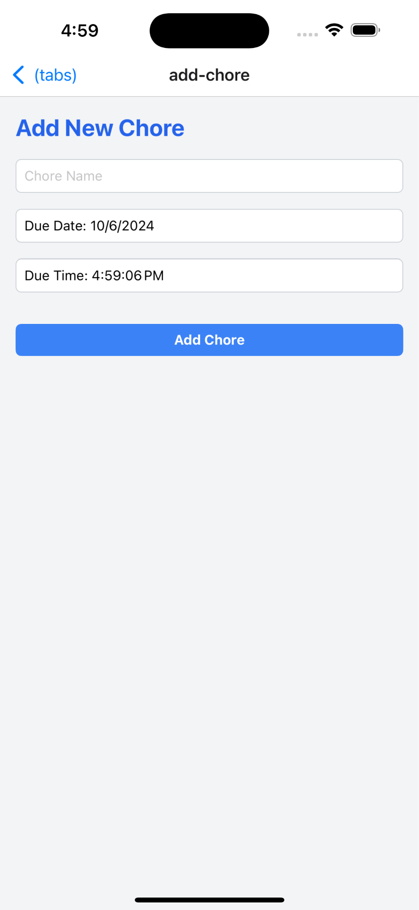
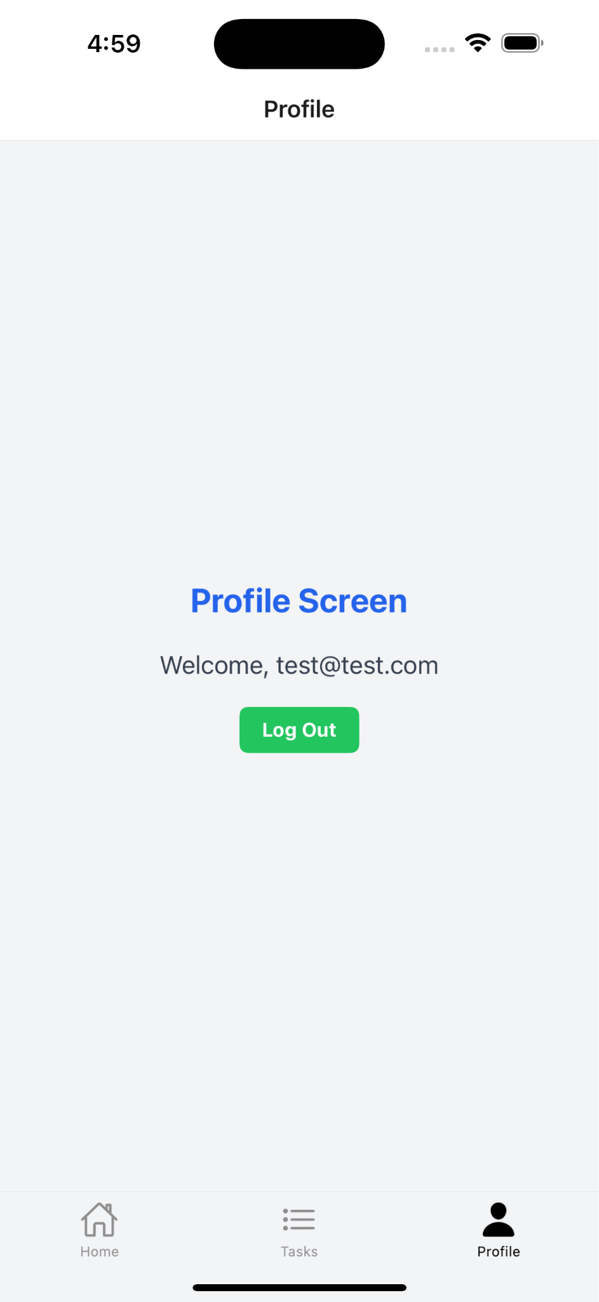
UI/UX of the Project

Slide 12
App Demo
Thank you!
Questions?

